Slide 1
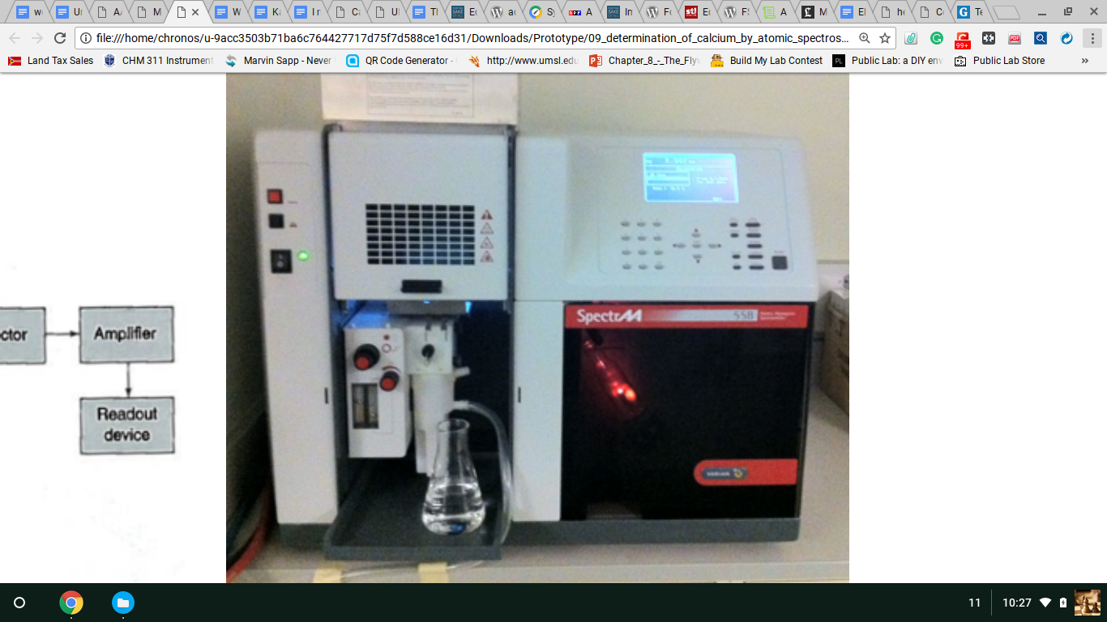
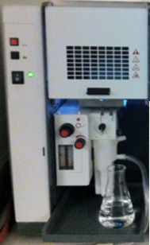
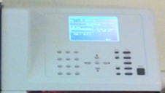
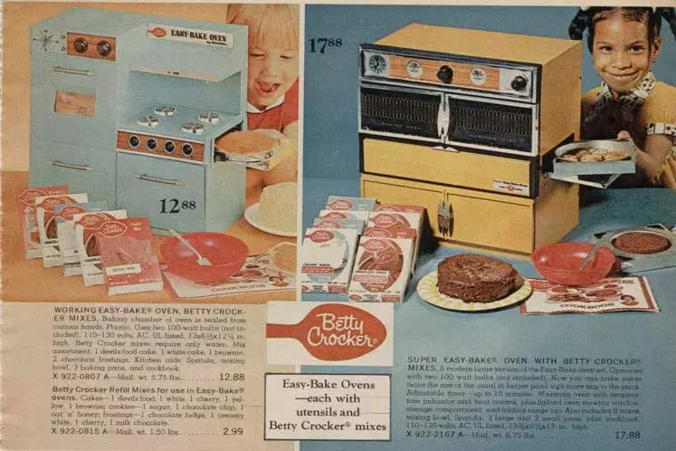
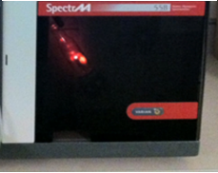
CONNECT-A-LAB Analytical Lab Equipment Simulator
When I was a kid my mother bought my sister an Easy Bake Oven to learn how to cook, because she was too young to learn in the Kitchen.
If You are Passionate About STEM Education in our Public Schools, then I have a bright Idea for You! It’s Called CONNECT-A-LAB, and it began a long Time Ago!
Now fast forward to today’s public school STEM labs. They are woefully under equipped, because analytical instruments are expensive, dangerous and hard to use. That’s why I invented….
The Easy Bake Oven was the perfect tool. It was inexpensive,
it was safe and it was Easy! And my sister learned how to follow recipes, use utensils and of course bake cakes. Yum, Yum!
CONNECT – A – LAB!!!
Allen Savage
10/04/2017

Slide 2
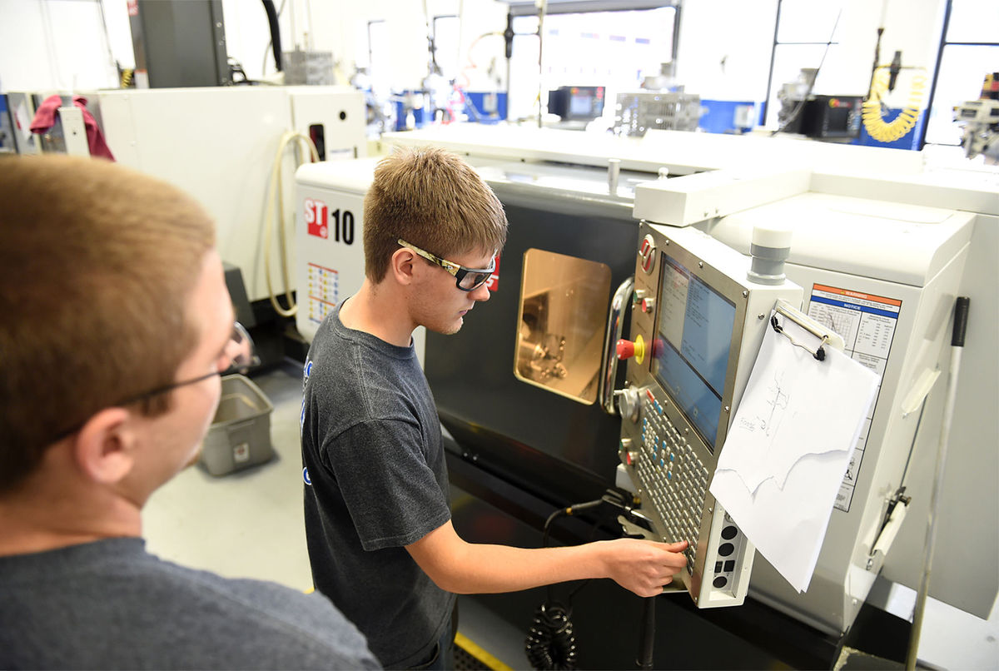
Some School Districts have money to spare, and can give their students a good start in a STEM Career with:
High Technology
Real Hands On
Safe, User Friendly
Buck County Technical High School Fairless Hills, PA
Joan Hellyer, s. (2015). Bucks County Technical HS students using high-tech machines to turn ideas into reality. Bucks County Courier Times. Retrieved 4 October 2017, from http://www.buckscountycouriertimes.com/news/local/bucks-county-technical-hs-students-using-high-tech-machines-to/article_ea17edec-7c1a-11e5-a67b-27debf41d92d.html

Slide 3
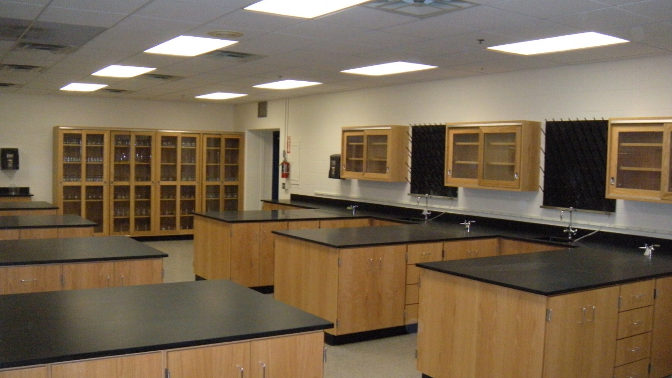
Money!!!
Expertise!!!
But Many Public School Districts have abandoned their STEM Laboratories due to Problems with:
Hazards!!!
Support Resourcing

Slide 4
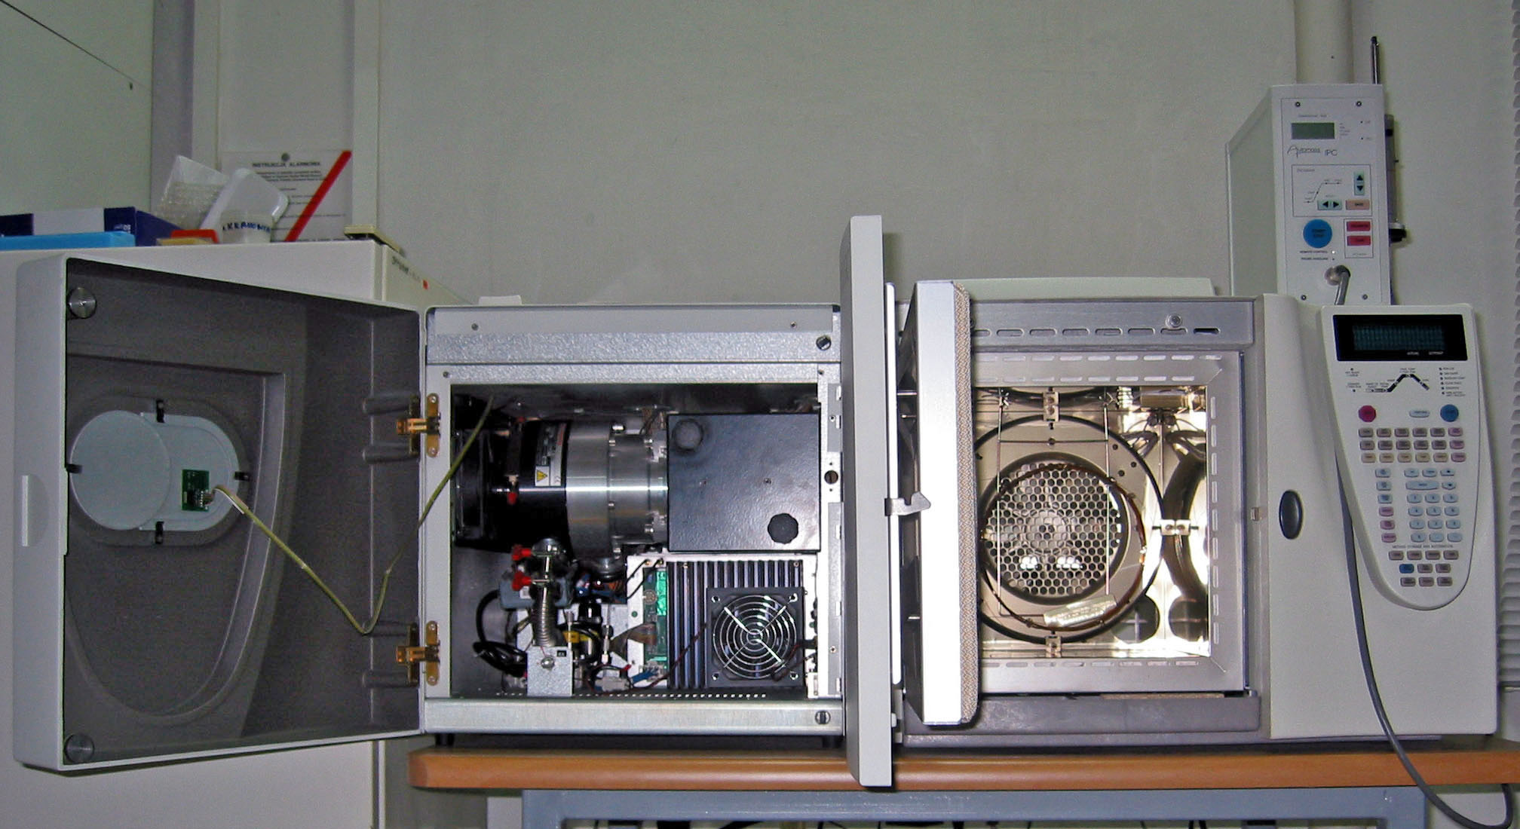



It’s what’s inside that’s EXPENSIVE! But what if we could replace All this with Something a little more Low Tech! Say…

Slide 5
Smart, Interchangeable, Cubes
That once assembled looks and acts just like the real thing!

Slide 6
And make an Atomic Absorption Spectrometer
For instance assemble cubes A1, A3, and B2 as such…

Slide 7
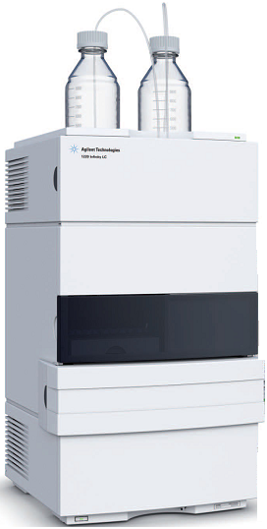
And you have a Liquid Chromatograph
Assemble them in a different Configuration…

Slide 8
Connect-A-Lab AAS
S²

Slide 9
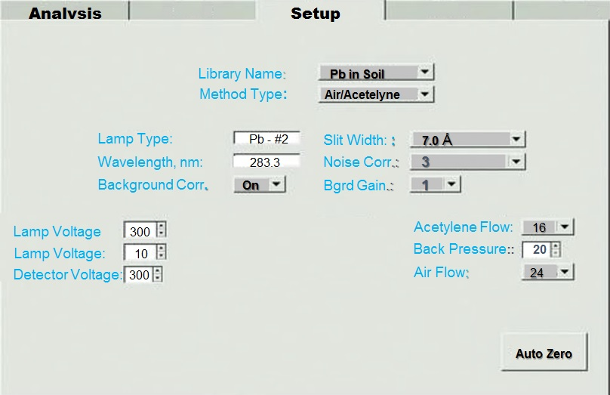

Slide 10
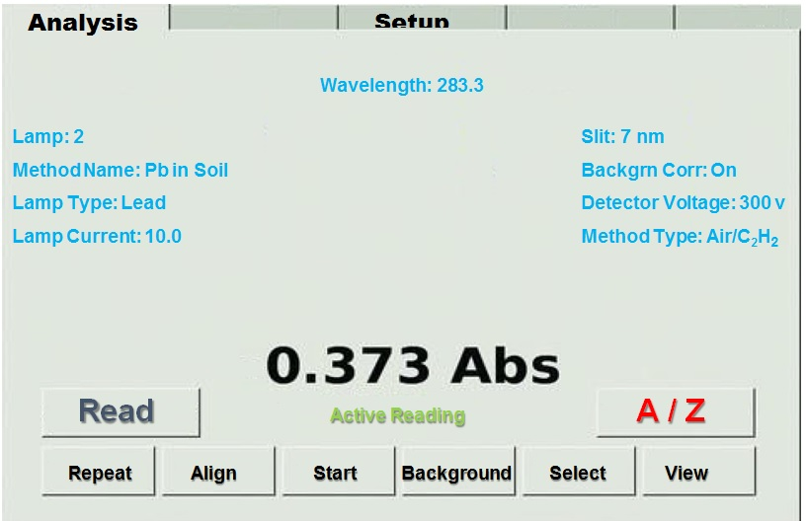
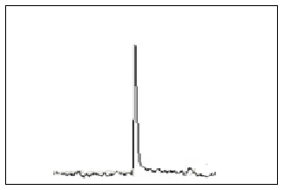

Slide 11
Checking Connection of Modules
Test voltage through smart connectors
If 0, then print on screen, “Only the Main Module is connected”
If voltage = 2, calculate voltage and print on screen, “Atomic Absorption Module is connected”
Test voltage from pH probe and Conductive probe
If pH probe voltage > 0 then load pH subroutine
If Conductivity probe current > 0 then load Cond subroutine
If both pH and Conductivity = 0 place module in standby mode

Slide 12
Running Atomic Absorption Mode
3. Reading Parameter input and Drawing Curve
Load AAS subroutine
Test Main Panel bus bar for voltages On/Off Button (v1), Slit width Control (v2), Detector Wavelength Monochromator(v3), D2 Background Compensator (v4), and Lamp Current(v5), Light Intensity Knob(v6), Auto Zero Button (v7), Read Button(v8), Air Flowmeter (v9), Fuel Flowmeter(v10) and store in appropriate memory locations
Read soft key pressed as Sample (S) or Calibration Standard (C) and inputted value. Store in appropriate memory locations
Use statistical subroutine to calculate and print calibration curve and statistics
Print curve to screen

Slide 13
Compensating Errors
4. During Modular Configuration Stage
If v1 = 0 display blank screen
If constant1 <v2> constant2 run chromatogram correction program 2
If constant3 <v3> constant4 run chromatogram correction program 3
If constant5 <v4> constant6 run chromatogram correction program 4
If constant7 <v5> constant8 run chromatogram correction program 2
If constant9 <v6> constant10 run chromatogram correction program 5
If constant11 <v9> constant12, or If constant13 <v10> constant14, Print Air/Fuel Mixture is not correct, Please adjust before continuing”

